Slide 1

Optimized Learning with Virtual Reality Summer 2020
Codey Winslow
Dr. Philip Howard

Slide 2
Goal of the Project
Can VR teach industry skills?
Is it a cheap alternative to mocking expensive setups?

Slide 3
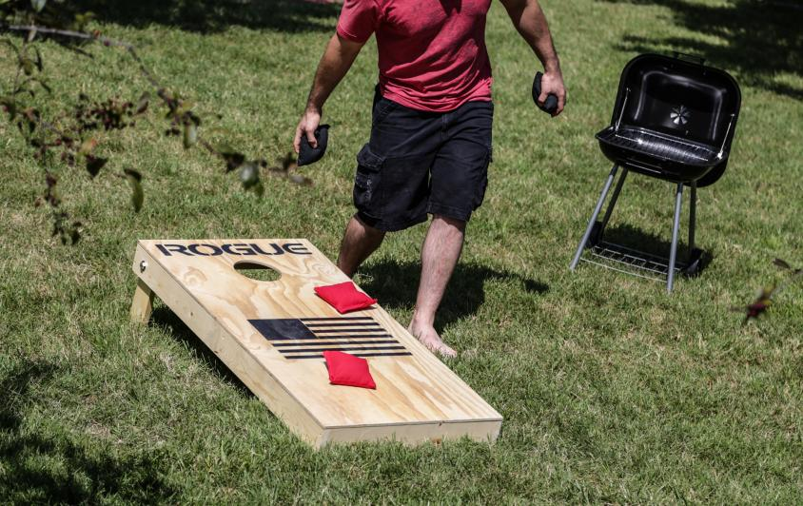
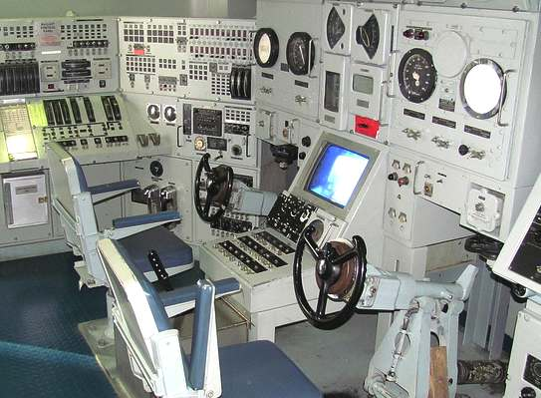
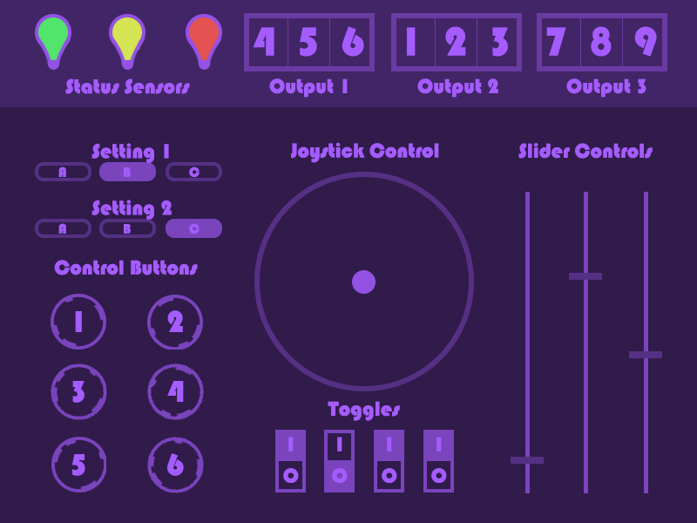
Plans for Execution
Initial
Cornhole
Procedure
Final
Touchscreen
3 Procedures
Simple
Intermediate
Advanced
2020 | Optimized Learning with Virtual Reality | Codey Winslow

Slide 4
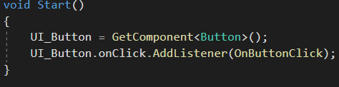
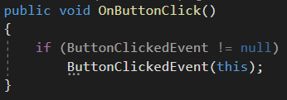
Building the UI
Decorate button click
Trigger event
Observer
notify
Control
trigger
Event
notify
Observer
notify
Observer

Slide 5
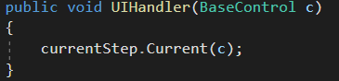
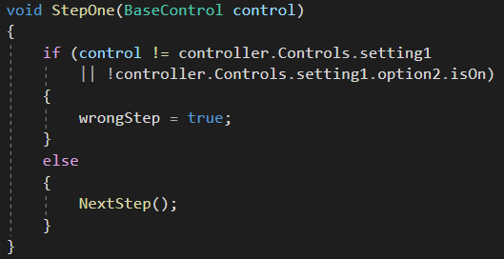
Building the UI – Level 1 Procedure
Call current Step function
Inspect action

Slide 6
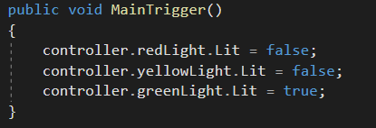
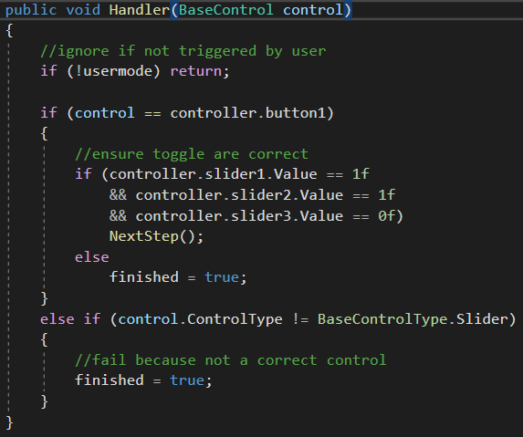
Building the UI – Level 2 Procedure
MainTrigger is called when task starts
Handler inspects all UI actions

Slide 7
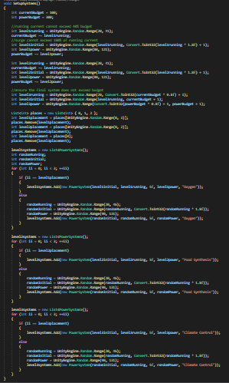
Building the UI – Level 3 Procedure
The hard part

Slide 8
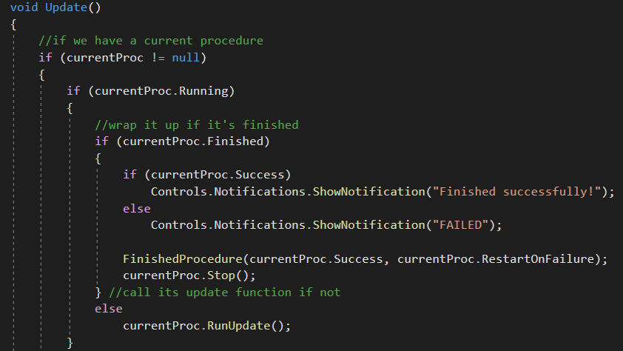
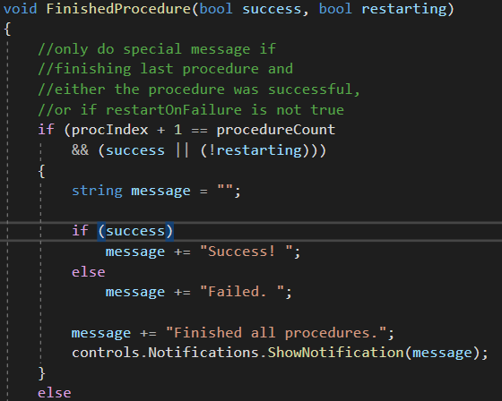
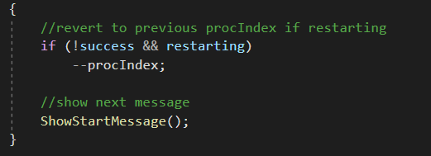
Building the UI – Procedure Controller
Run procedure’s update loop
Display result when finished

Slide 9
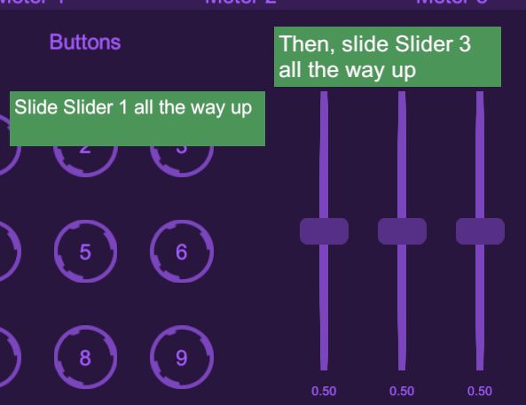
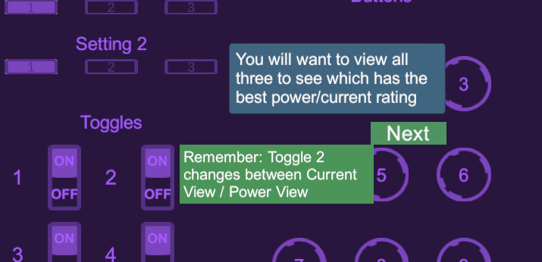
Building the UI – Tutorials
Hints for what to do next
Next buttons to move on

Slide 10

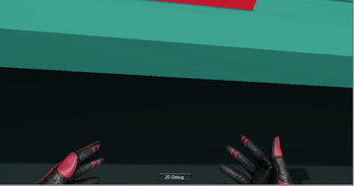
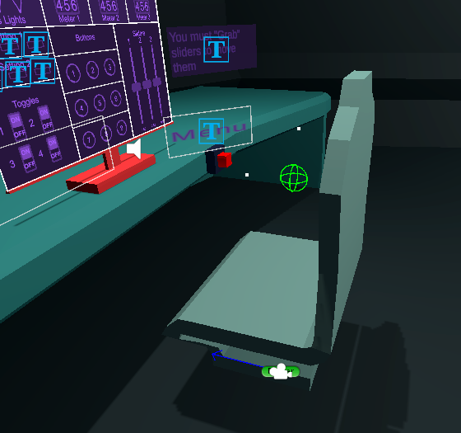
Implementing VR Behavior

Slide 11
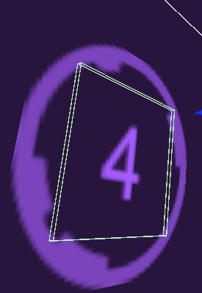
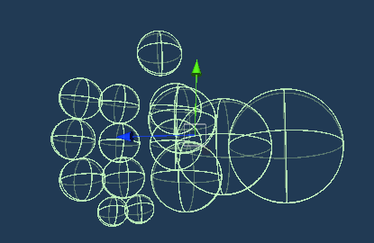
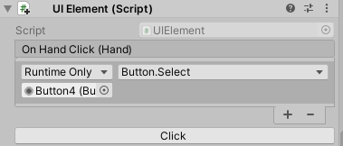
Implementing VR Behavior - Touchscreen
Touchscreen Button Collider
Hand colliders
Component captures hand collision

Slide 12
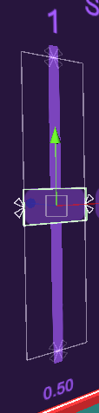
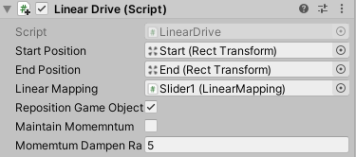
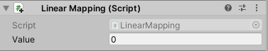
Implementing VR Behavior - Sliders
end
Updates value of component
start

Slide 13
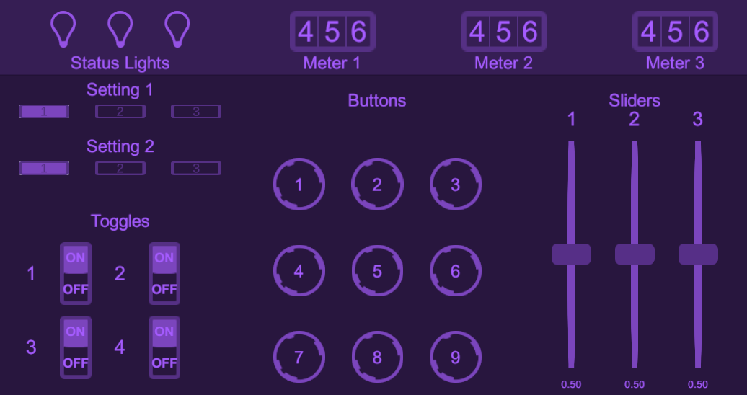
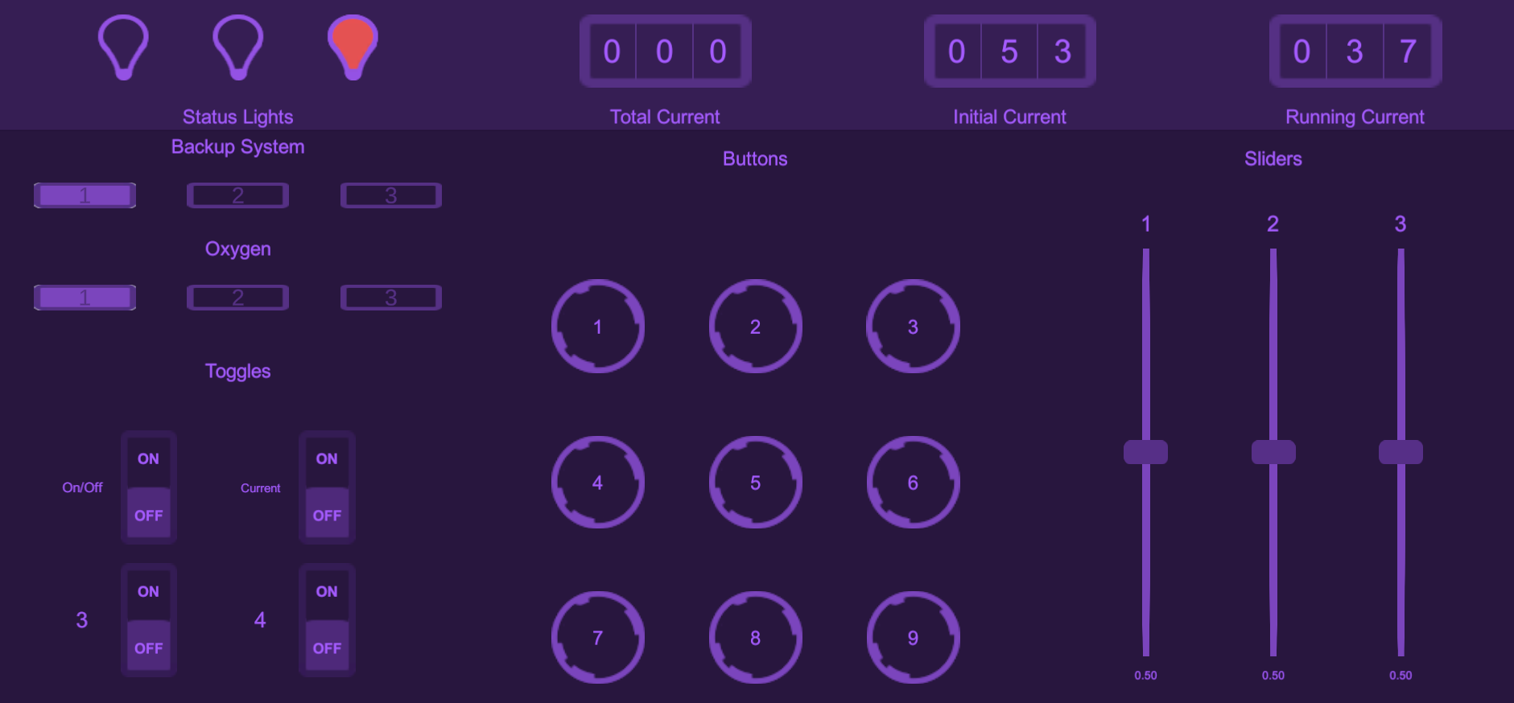
Testing
Not descriptive
More helpful

Slide 14
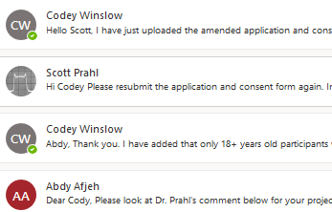
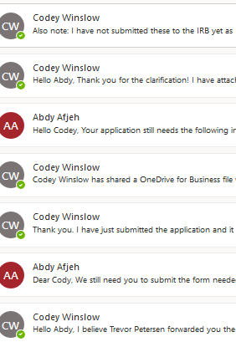
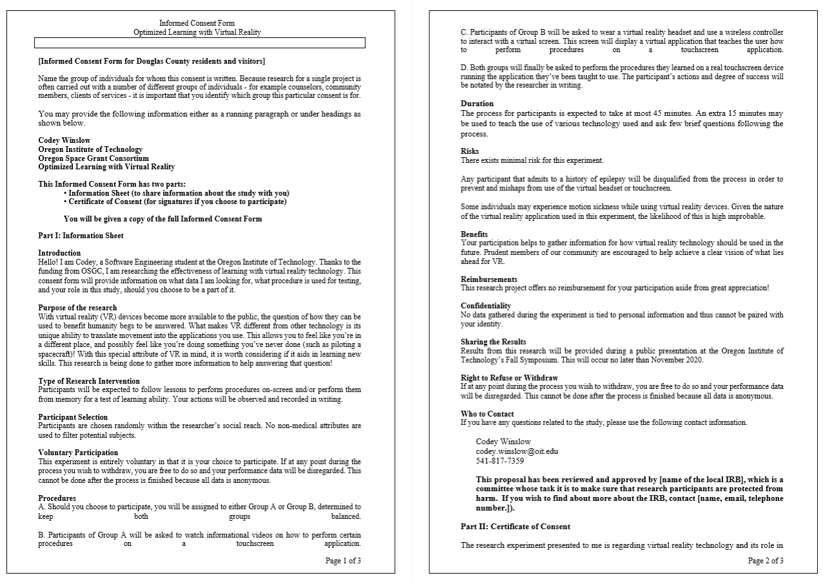
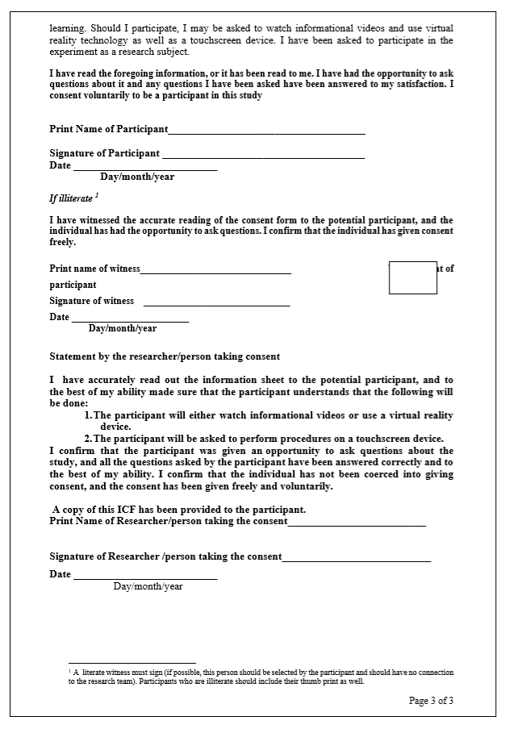
Human Subject Approval
2 weeks of emailing
Informed Consent Form

Slide 15



Worthwhile Experience
Deal with distractions
Build focusing skills

Slide 16
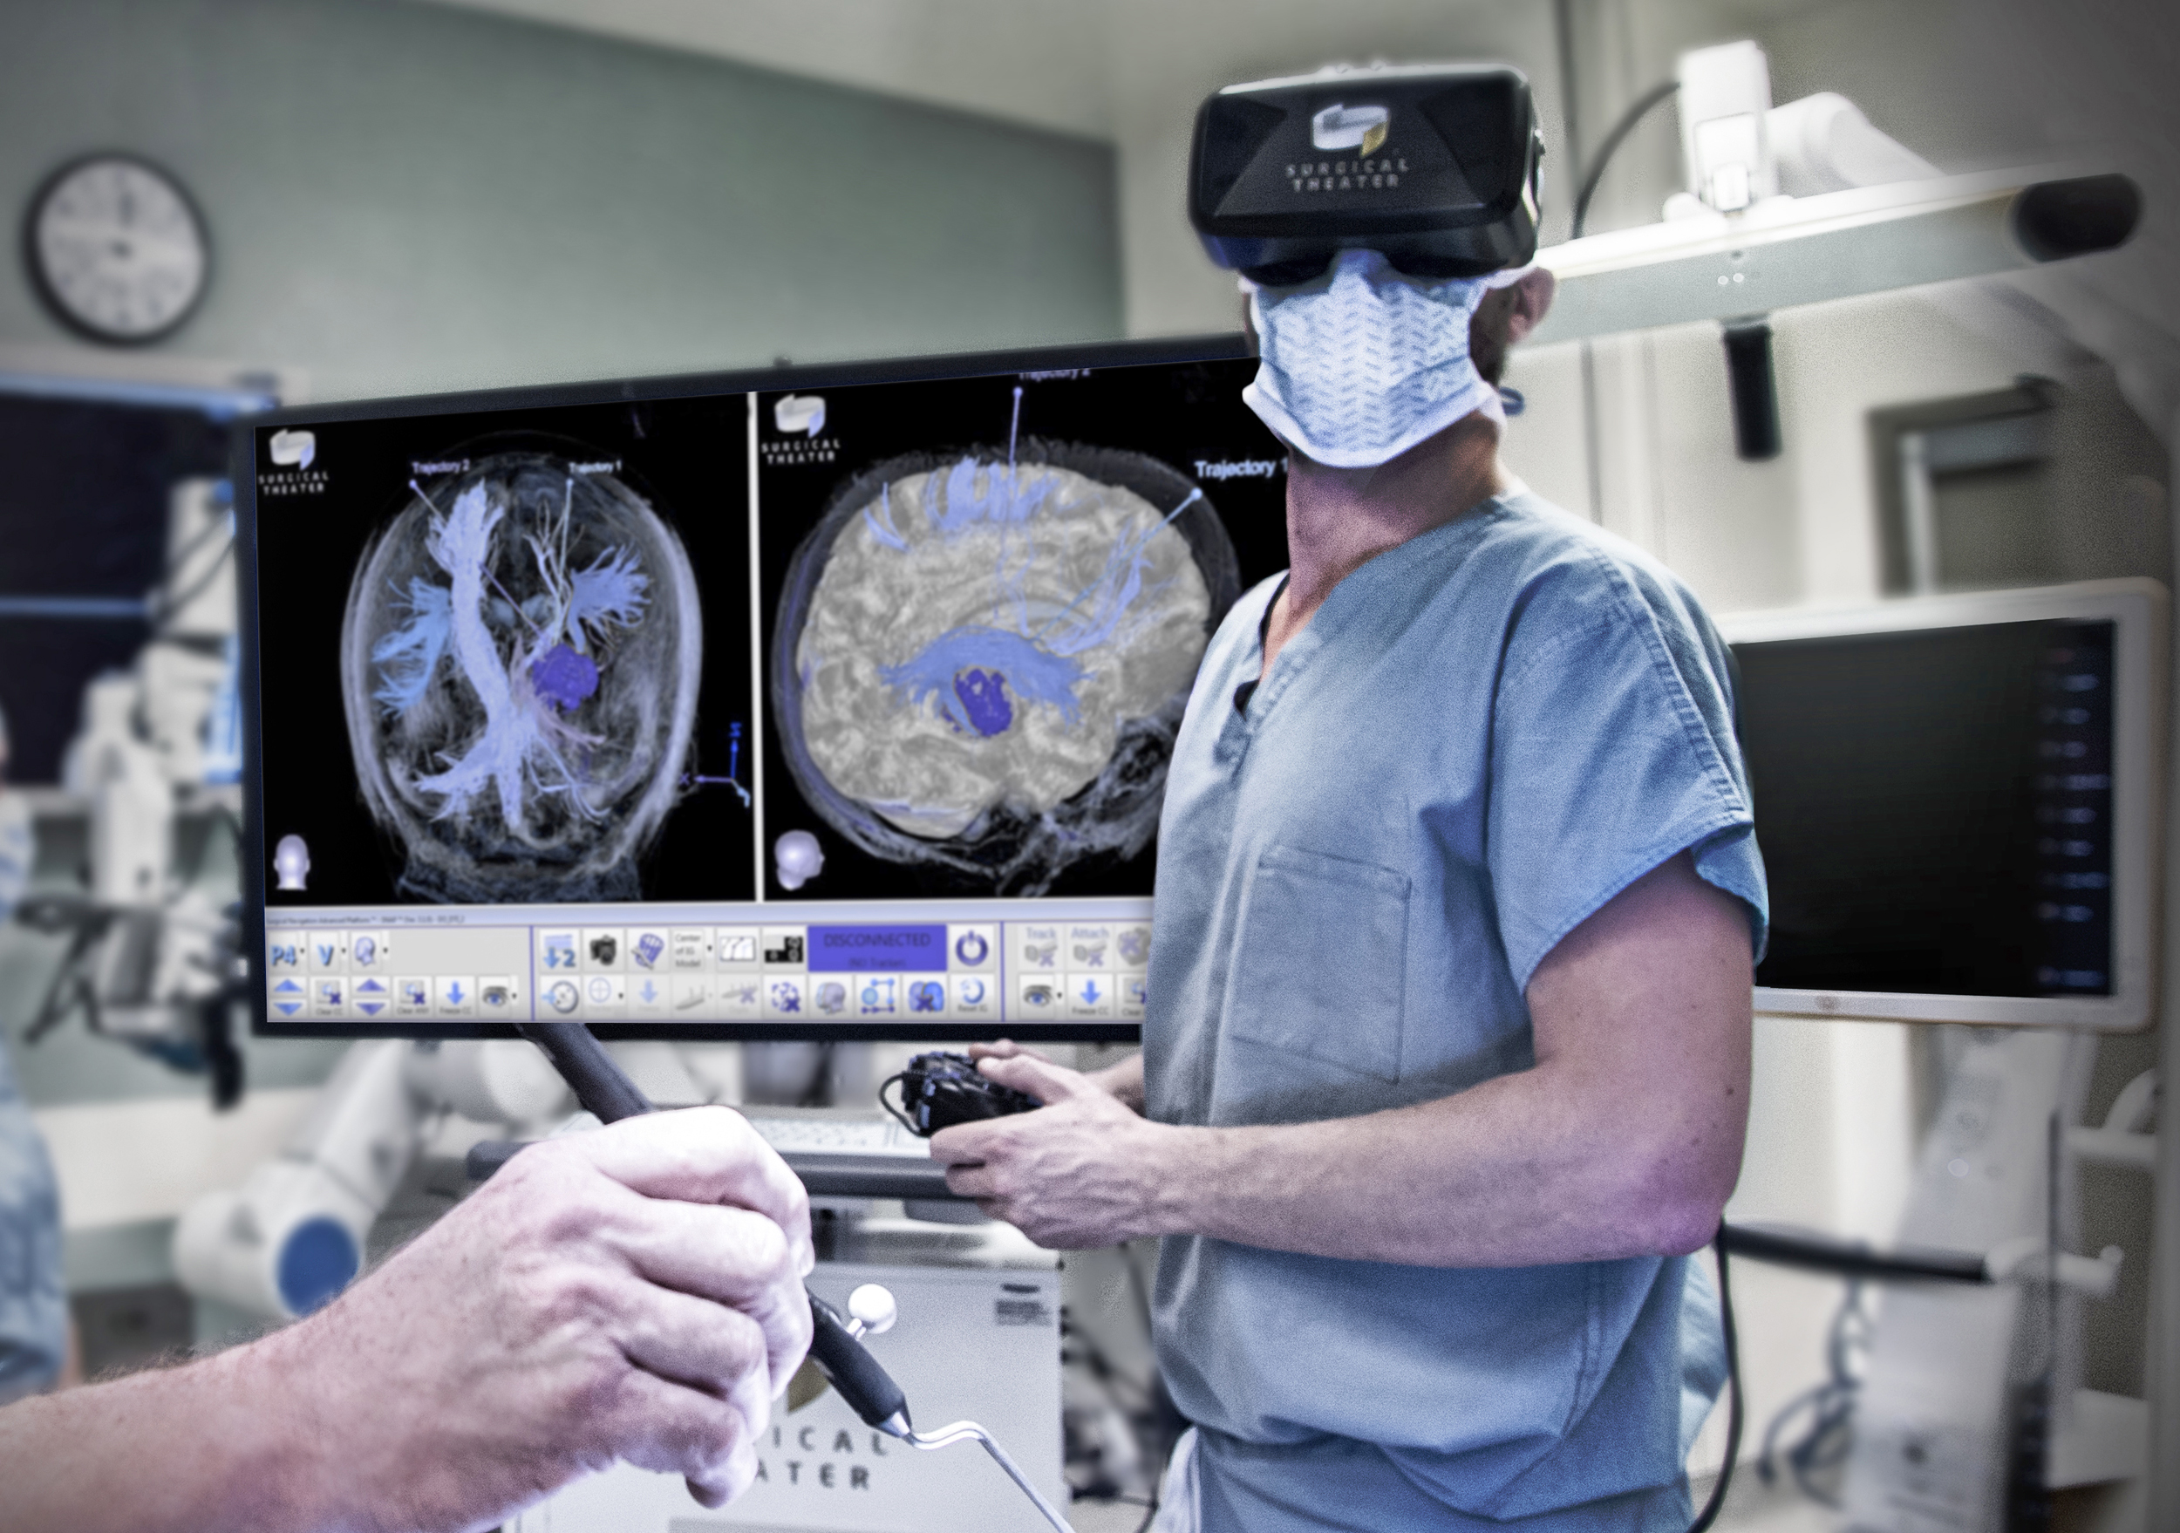

What Lies Ahead
Can physical skills be learned better in VR?
What other potentials does VR technology hold?

Slide 17
Thanks for coming!
Questions? (2 min)
Contact me at codey.winslow@oit.edu

